Slide 1

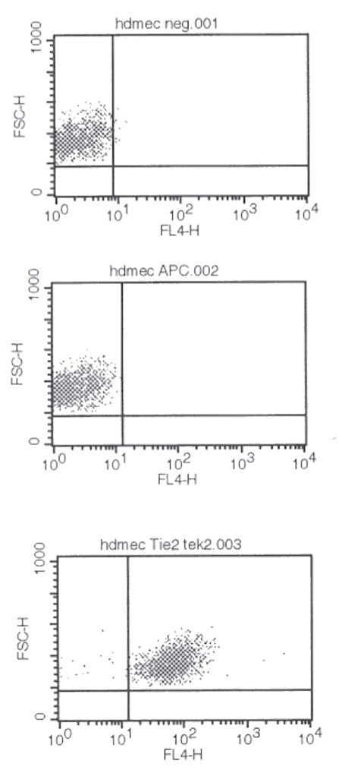
ReliaTech GmbH
Mouse anti-human TIE-2 (#tek2)
(Cat #101-M50)
Fig. 1: FACS analysis with primary human dermal microvascular endothelial cells (HDMEC).
http://www.reliatech.de / orders@reliatech.de

